Slide 1
Earthquakes and
Air Quality
Bowen, David, Jon, Kassaye, Lakre, Ron,

Slide 2
Hypothesis
Earthquake events will cause an increase in carbon monoxide, sulfur dioxide, nitrogen dioxide and ozone in the area radiating from the earthquake epicenter.
Question we asked: Do earthquakes have an effect on the air quality in surrounding areas?
We think yes.
Notes:
This project came about through brainstorming topics that have large data sets and also had working and accessible API’s. Environmental issues were identified as a key theme of interest for most of our group members and one team member has family working for the United States Geological Survey and learned about interesting earthquake data sets through his connections.
We decided to combine the two ideas and although it seemed a stretch to assume there would be a relationship between earthquakes and air quality, we did come across a compelling study in Taiwan that analyzed earthquakes and air quality, though those findings suggested there would be a spike in gas emissions BEFORE the earthquake event.
Based on our layman knowledge of earthquakes and capability to destroy man-made structures such as factories and gas lines, along with disturbing natural gasses, we hypothesize there will be a correlation between earthquake events and air quality ( more presence of carbon monoxide, sulfur dioxide, nitrogen dioxide, and ozone).

Slide 3
Data presentation and analysis
2 API’s:
Environmental Protection Agency (EPA)
United States Geological Survey (USGS)
Data exploration and clean up process:
Notes:
For our project, we used 2 API’s to search for earthquakes in the continental US and air quality in the days before and after the earthquake event.
> First we found an earthquake of Magnitude 7 and played with the AQI Dataset from the EPA. Looked at 1 week of data from 1-degree radius from the epicenter. Looked at mean of all samples.
>Once we played with that, we decided to expand to looking at about 75 earthquakes at magnitude 5 and above, looking at daily means rather than at every sample and spanning a month before and after the earthquake. From there we looked back in time from current to see which ones appeared to have enough data… which ones had readings for each day for most of the pollutants.
We decided to limit our project to 10 earthquake events that were recorded between a magnitude of 5.0 and 6.0.
Had issues with the EPA API
This magnitude parameter yielded the most results for air quality data. We suspect earthquake events below 5.0 do not produce enough of a disturbance to increase gas emissions

Slide 4
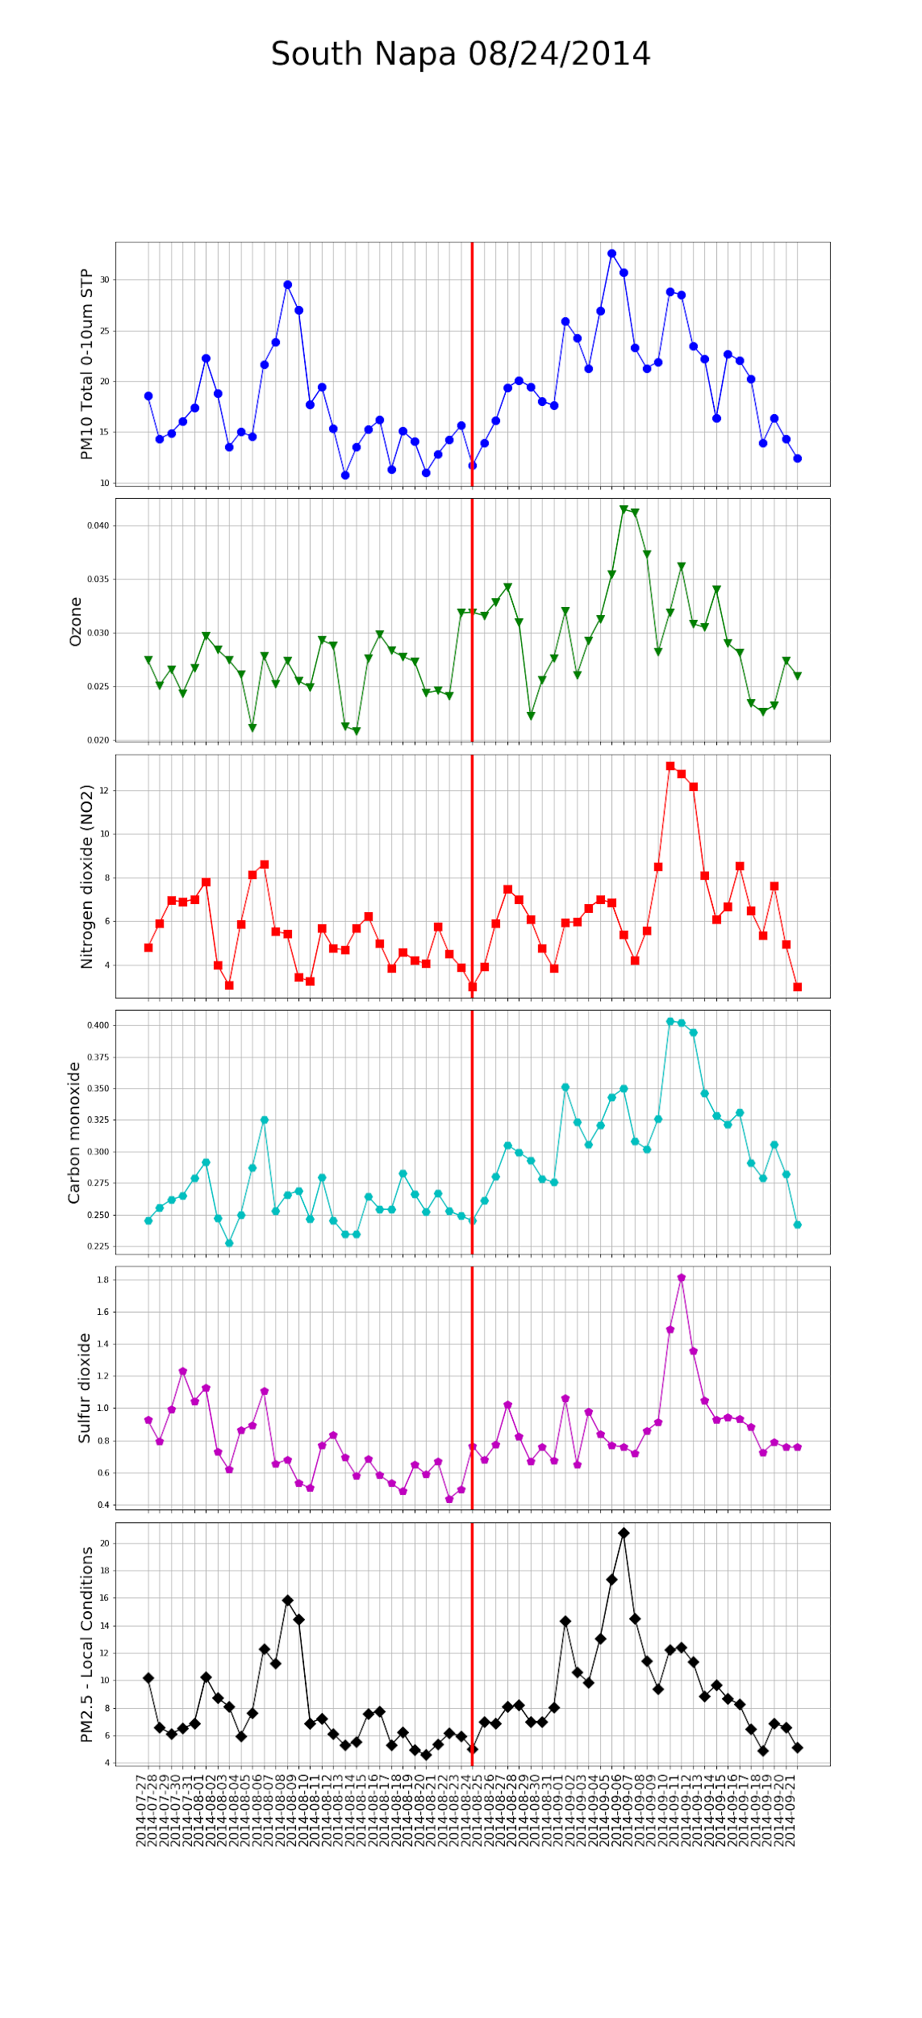
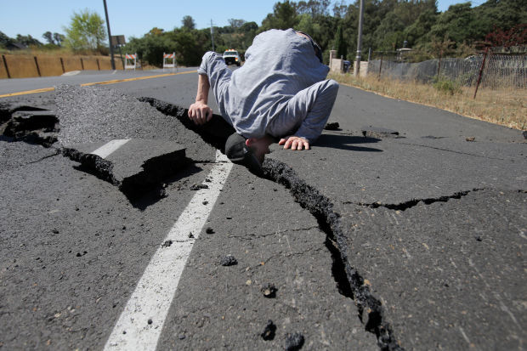
South Napa Earthquake
Notes:
We’re not going to show all the data from all 10 earthquakes we recorded. We chose the South Napa earthquake of 2014 as an example of the data we collected. We have the data aggregated into subplots based on the 4 gasses that we wanted to get information about + particulate matter in the air. To see the data better we separated the gasses into separate charts.

Slide 5
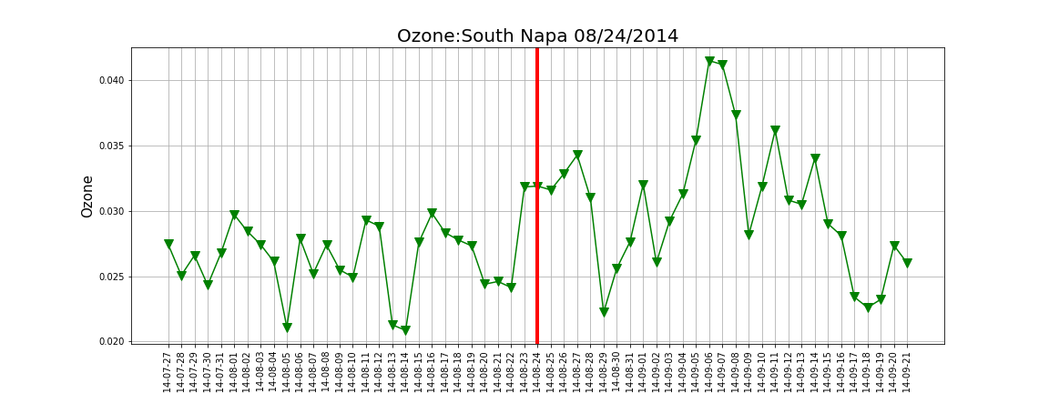
Ozone
Notes:
Red line is the earthquake event.
Days on the x-axis.
Each tick is a day.
Gas measurements on the y-axis.

Slide 6
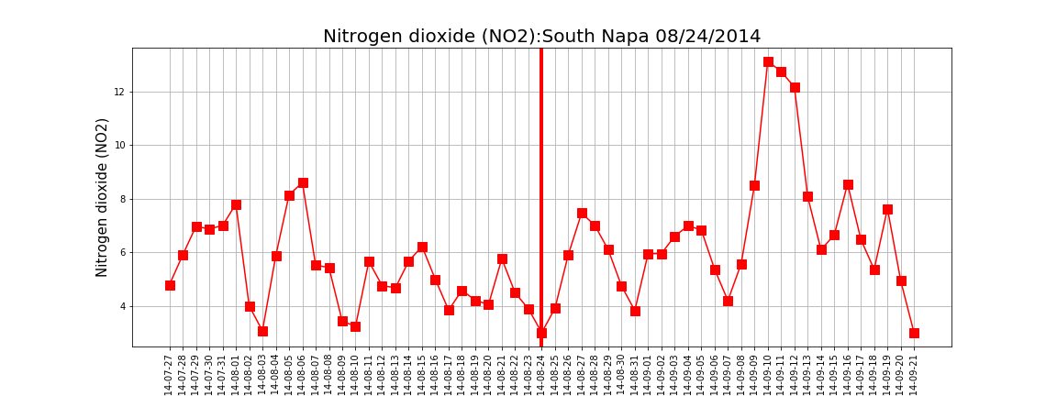
Nitrogen Dioxide

Slide 7
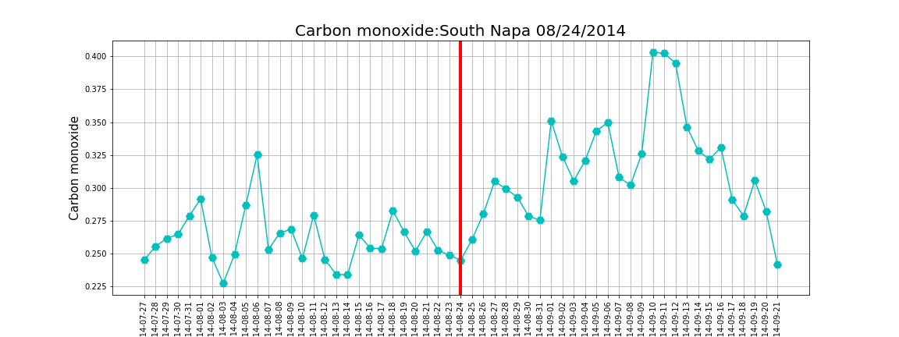
Carbon Monoxide

Slide 8
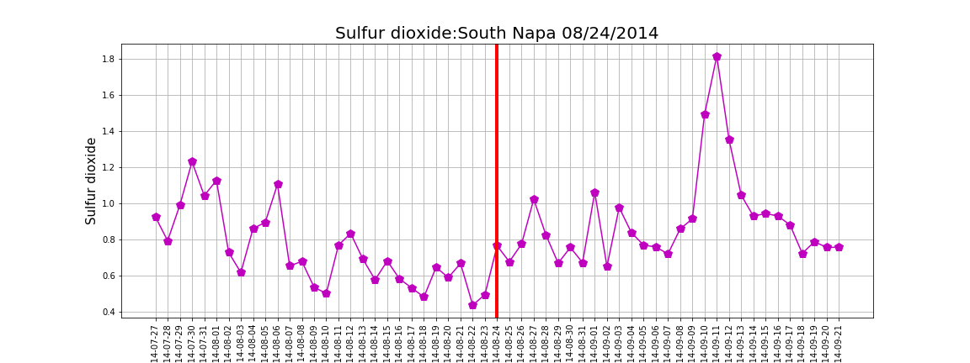
Sulfur Dioxide

Slide 9
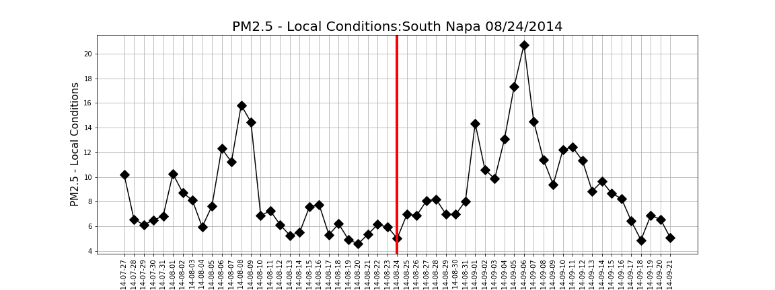
Particulate matter 2.5 mm

Slide 10
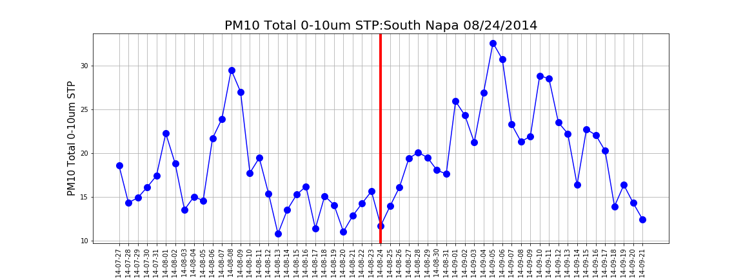
Particulate matter 10 mm

Slide 11
Conclusions
Do earthquakes have an effect on the air quality in surrounding areas?
Maybe, but not consistently
There is not much of a consistent correlation between earthquakes and air quality getting worse.
Future development:
Cool gmaps project
Statistical summary
Notes:
From our data analysis and research process, we concluded that there was little correlation between earthquakes and the release of gases at the earthquake epicenter. Observed, not statistical.
We based our project off of an interesting study that we found from Taiwan and we thought it would be really cool to explore this idea further. While we were a little disappointed to not find any correlation, we weren’t particularly surprised.
Interestingly enough, there was one graph that did show a rise in carbon monoxide but it was due to the forest fires that resulted from the earthquakes rather than the actual earthquakes.
There were some things that we didn’t quite get to. Bowen created a gmaps jupyter notebook that was interactive and would allow you to click on an earthquake and it would show you certain data about it, including magnitude amounts of gasses measured. It didn’t quite make it to production and if we had more time, it would have been a cool addition.
In conclusion, when we ask the question, ‘Do earthquakes have an effect on the air quality in surrounding areas?’ we have decided that we don’t see any correlation and that they probably don’t have any effect.

Slide 12
Questions?

Slide 13
Thank you!

